Slide 1
Project DataBase Hotel
Supervisor By DR. Asmaa Alayed.

Slide 2
Students’ names of project
Leader
Logain Batouq
439006070_2
Roba Abdurahman
439012201_2
Shahad Almofarji
438013491_2
Thekra Alhsani
437035939_2

Slide 3
Project Phase
1
2
3
4
Phase 1
Phase 2
Phase 3
Phase 4
Conceptual Design
Logical Design
Physical Design
Collection of all previous phases.

Slide 4
1
Phase 1
Conceptual Design

Slide 5
The Description
An Investment company named Wyndham International Hotel Chain (WIHC) plans to create a database system for its new hotels in Saudi Arabia specifically in Jeddah city, to keep track of the information about its employees, guests, and Reservations.
• The Hotel has name, hotel Id, location, star rate, and many branches. Also, the hotel consists of
employees service the guests, and Reservations and owns a number of rooms, where receptionist employee are assigned to confirm reservations.
• Each employee has a ID, first name, last name, address, phone number and salary.
• One of the most important employees has in the hotel is the receptionist, each receptionist confirms one or more reservations for more than one guest at the time his work, Also each receptionist work on hotel has a name, Email and work time.
• In WIHC hotels have many guests from all over the country, And for each guest has an ID, first
name, last name, address, phone number, gender.
• In hotel, each guest can be make reservation specifically for the room type of his choice, and the reservation in hotel must have a start date and end date to issue bill containing the guest's name, reservation number, total amount of the reservation and services.
• Also, each room in the Hotel has a number of rooms and different room types, and the room type has room name, room number and price.
• The bill according to the room type they have reserved, And each reservation is confirmed with only one billed.

Slide 6
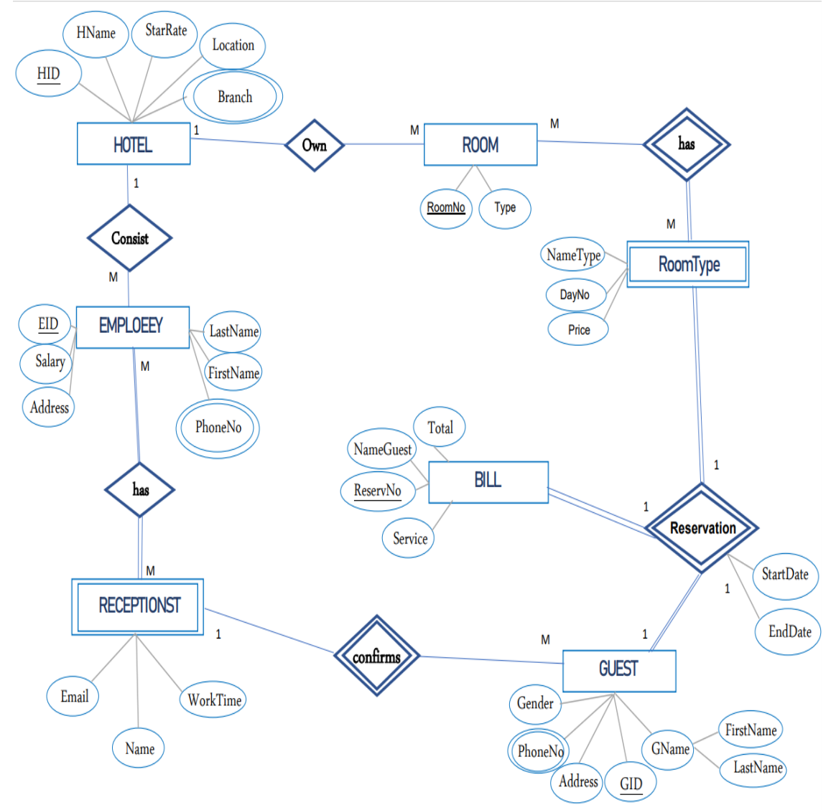
Chen's Notation

Slide 7
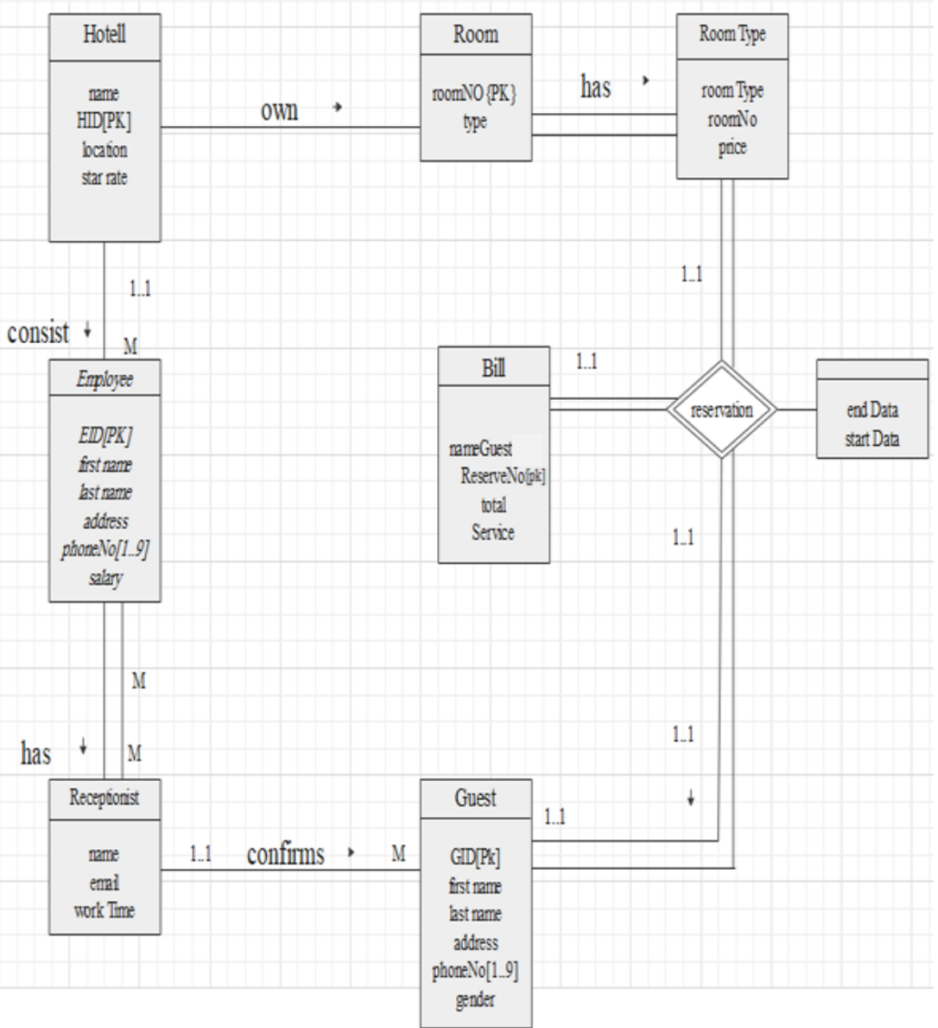
UML Notation

Slide 8
2
Phase 2
Logical Design

Slide 9
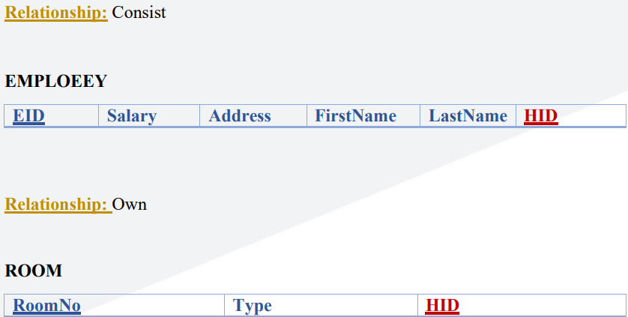
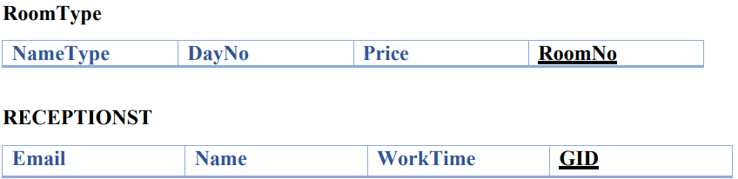
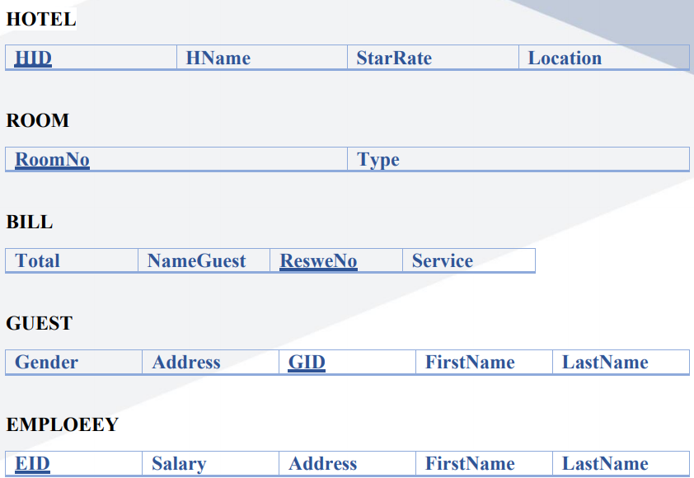
Relational Schema
STEP 1
Mapping of Weak Entity Type
STEP 3
Mapping of Binary 1:M Relationship Type
STEP 2
STEP 4
Mapping of Regular Entity Type
Mapping of Binary 1:1 Relationship Type

Slide 10
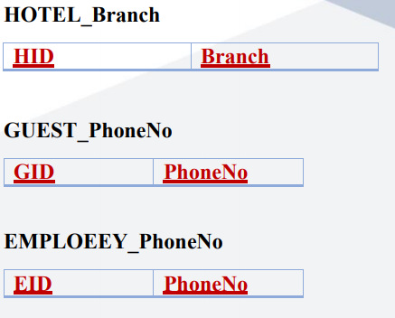
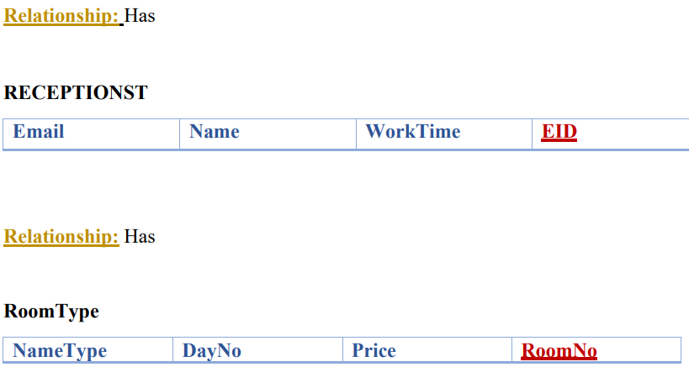
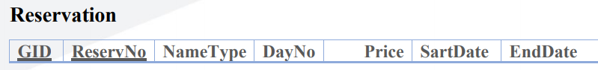
Relational Schema
STEP 5
Mapping of Multivalued Attributes
STEP 7
STEP 6
Mapping of Binary M:N Relationship Type
Mapping of N-ary Relationship Types

Slide 11
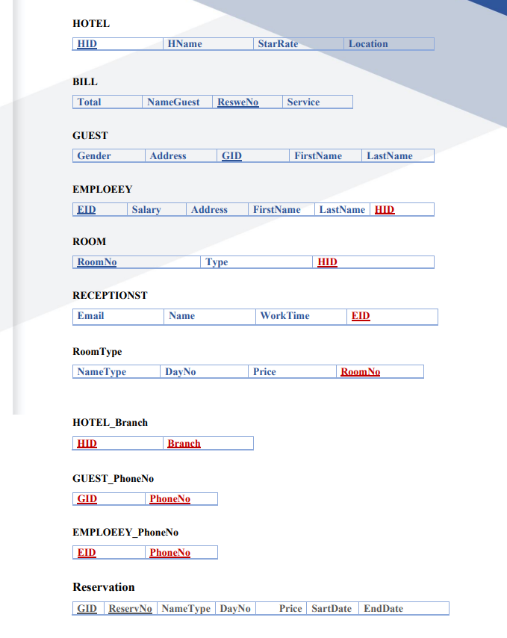
Final Mapping

Slide 12
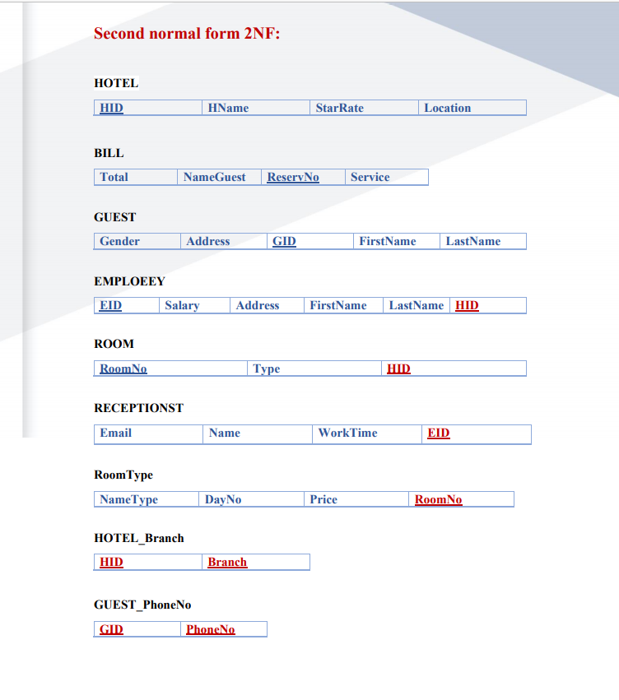
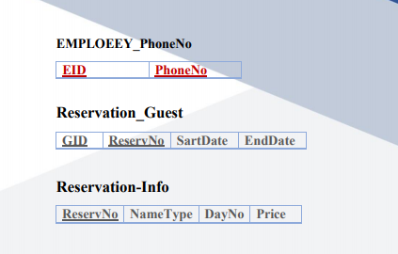
Normalization
Second normal form 2NF:
First normal form NF1:
The schema is already in final map
Third Normal Form NF3:
The No Transitive Dependency

Slide 13
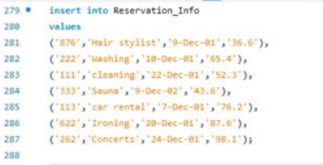
CREATE SCHEMA
CREATE TABLE
INSERT
UPDATE
DELETE

Slide 14
3
Phase 3
Physical Design

Slide 15
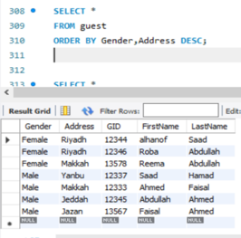
CREATE SCHEMA
INSERT
UPDATE
DELETE

Slide 16
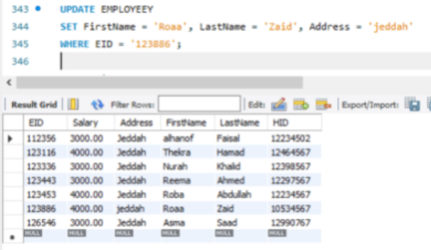
CREATE SCHEMA
INSERT
UPDATE
DELETE

Slide 17
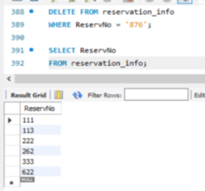
CREATE SCHEMA
INSERT
UPDATE
DELETE

Slide 18
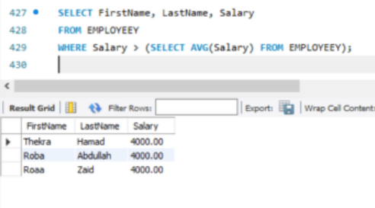
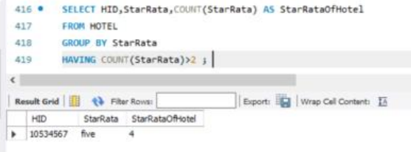
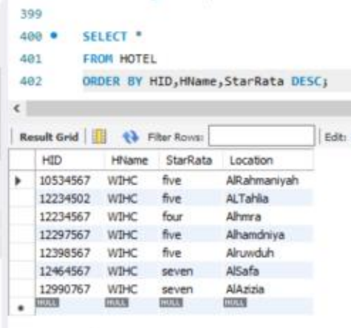
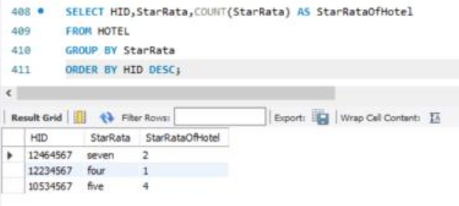
1
2
4
3

Slide 19
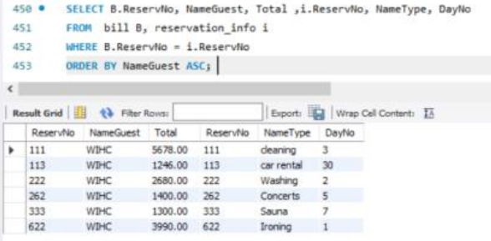
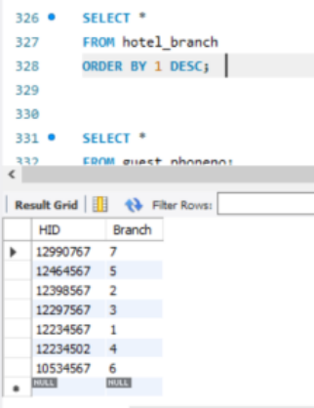
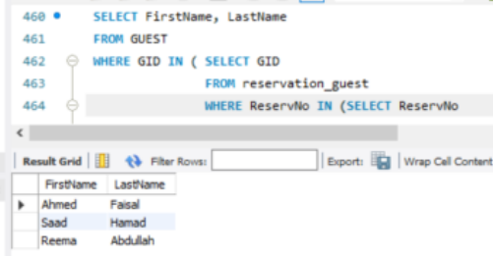
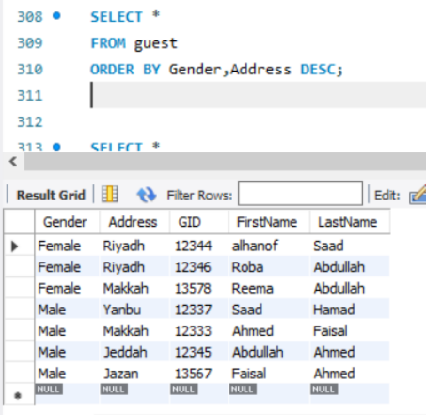
5
6
8
7

Slide 20
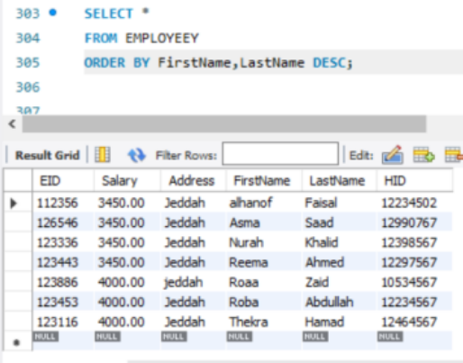
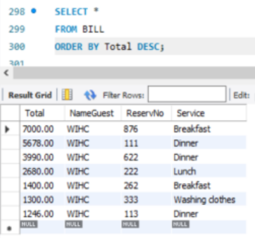
9
10

Slide 21
Correct description of the idea
Determine the correct data type of variables
Create a tables
Insert the elements as required
challenges
How to represent relationships in a UML diagram
In the normalization stage - Confusion -
Difficulty choosing the correct table to delete from, because there are so many forgin keys in our idea
Create a tables correct format

Slide 22

THANK YOU

